Slide 1


Healthcare Monitoring System using Fog Computing
Liya V John

Slide 2


Description of the Project
This system is a real life healthcare application platform for heart patients.
It analyses and identifies heart diseases automatically.
It delivers diverse healthcare configurations for different user requirements.
It is a fog enabled cloud computing model for healthcare which uses deep neural network to do the prediction.

Slide 3
Relevance of the topic
Cloud Computing provides resources, services and also helps in deployment of application.
Projects that include the use of cloud-based IoT devices require a high degree of performance goal requirements. IoT implementations request the Cloud's immediate answer.
Therefore, Fog computing is introduced, where extends cloud computing and services to the edge of the network.
Healthcare sector is a latency sensitive area in which real time data analysis is required.
Deep neural network can predict and classify health related data at high accuracy, but are compute intensive. As accuracy increases, the network become compute intensive which in-turn increases latency.
Therefore fog computing has been used which is well positioned for real time big data analysis and reduces response time by allowing to leverage edge resources.

Slide 4
Objectives
The goal of this project is the real time data analysis for diagnosis of heart disease.
Development of an integrated fog-cloud based computation model.
To apply different deep learning techniques over the large existing heart disease dataset, which is based on the risk factors.
Development of an android application which integrates with fog computing platform.
To provide a personalized warning based on heart risk
Provide blockchain features to the Iot-fog-cloud model.

Slide 5
Existing System
Diagnosis of the condition solely depends upon the Doctors’ intuition and patient’s current health status.
When you first arrive at hospital with a suspected attack, the doctor wants to find out as much as they can about your symptoms.
A number of tests can be done to confirm the diagnosis and determine the cause of the attack.
The process is costly and time consuming and can lead to errors, biases and unwanted medical costs which affects the quality of service provided to patients.
Cloud based prediction and monitoring systems are available but latency-sensitive applications like health monitoring and surveillance systems now require computation over large amounts of data (Big Data) transferred to centralized database and from database to cloud data centers which leads to drop in performance of such systems.

Slide 6
Proposed System
The proposed work provides a novel framework for integrating deep learning in Edge computing devices and deployed it for a real-life application of automatic Heart Disease analysis.
The proposed work predicts the chances of heart disease by exploring deep neural network.
It does performance analysis based on the excecution time taken by fog nodes and cloud. Thereby proves latency problem in cloud and also provides solution through fog.
It delivers healthcare as a fog service.
Fog-enabled cloud framework, FogBus is used to deploy the proposed model.
Deep learning models are developed and trained using datasets and are deployed on fog nodes

Slide 7
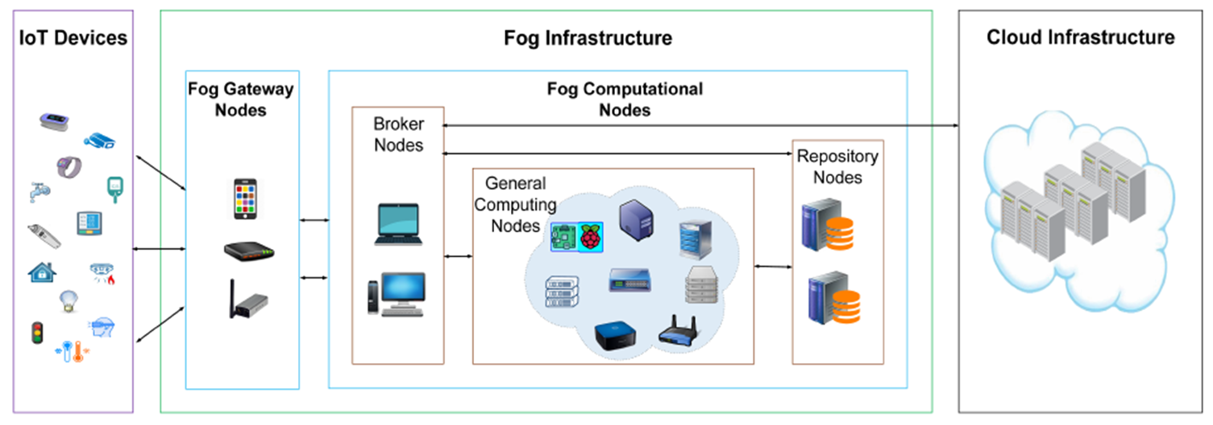
FogBus Framework
A Blockchain-based Lightweight Framework for Edge and Fog Computing

Slide 8
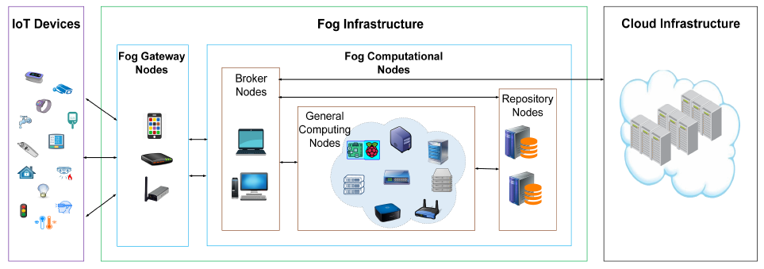
Hardware Instruments
IoT devices:
Sensors that perceive the external environment
Fog Gateway Nodes (FGN):
Entry points of distributed computing infrastructure.
User interfaces of applications
Data filtration
Organize data in a general format.
Aggregate the data received from different sources

Slide 9
Hardware Instruments
Fog Computational Nodes (FCN):
FCNs are heterogeneous in terms of capacity and resource architecture.
They are equipped with processing cores, memory, storage and bandwidth.
Based on these operations, FCNs can act in three different roles:
Broker nodes :
Distributes the computational tasks over multiple FCNs and monitors, synchronizes and coordinates their activities.
General Computing Nodes (GCNs):
For general computing purposes and accessible via broker nodes.
A general computing node can simultaneously serve multiple broker nodes.
Cloud datacenters:
When Fog infrastructure becomes overloaded
FogBus extends resources from Cloud datacenters to execute back-end IoT applications.

Slide 10
Blockchain Feature of FogBus:
In FogBus, the masters create the blocks from received data and calculate the hash of each block based on the data, hash of the previous block, time stamp and a nonce value using SHA256 algorithm
Masters also create random public private key pairs that help to generate unique signatures with the original data.
Later they share Blockchain details, digital signature attributes and the data in Base64 encoding format with workers.
With the received public key of the masters, the workers are able to verify that the data is coming from a legitimate source.
If any other key is used, that data is rejected.
The public-private key pair in this case is kept dynamic per block to prevent the generation of private key using brute force techniques.
Each block and its hash are verified at the workers by mining the nonce value that supports the proof-of-work.

Slide 11
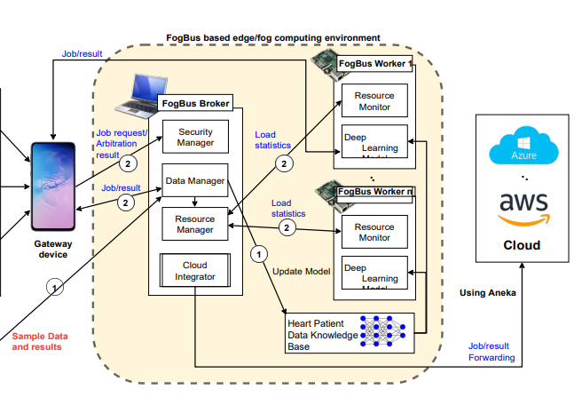







System Design

Slide 12
Deep Neural Network
The project adapts a multilayer perceptron classifier which is a feedforward neural network that generates an output from a set of inputs.
It consist of 13 hidden layers.
The weight optimization is done by solver called adam. The solver adam is a stochastic gradient based optimizer.

Slide 13
Fog Gateway node
An android executable named QuickHeartTest launches the android interface.
The executable installed on the Smartphone allows the device to send data to the Broker/Worker nodes.
The communication is achieved using HTTP RESTful APIs.
We used HTTP POST to upload input data from and download results to the Gateway device.
It is developed on MIT App Inventor, an open source platform.

Slide 14
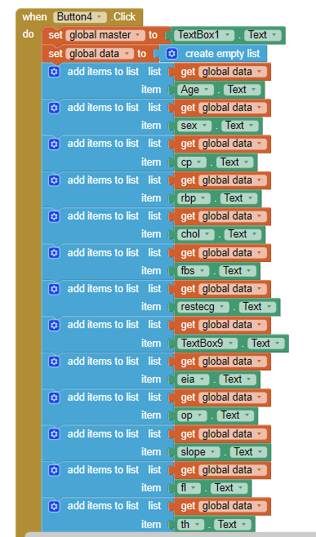
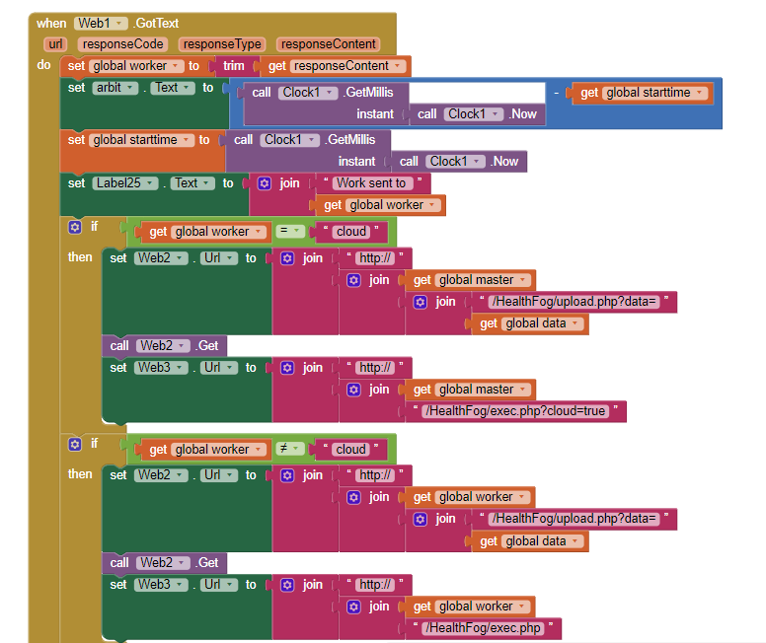
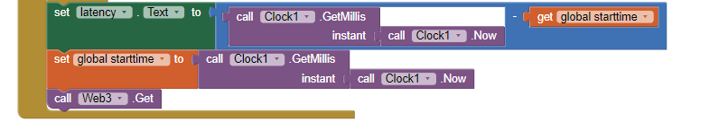
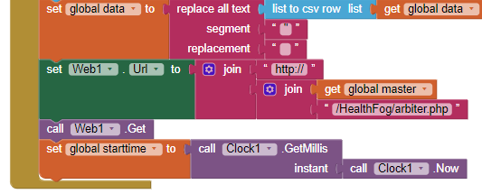

Slide 15
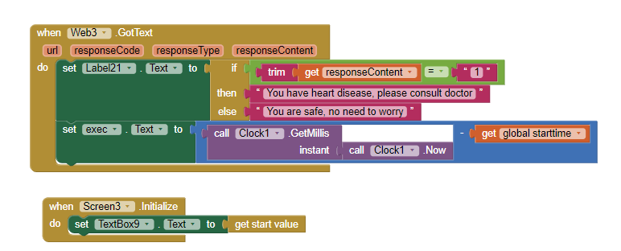

Slide 16

Input
Output
An android executable named QuickHeartTest was used.
A Questionnaire is provided in the app which need to be filled in by the user.
It consists of 13 questions whose answers goes in as inputs like age, sex, chest_pain, Rest_bps, cholesterol, fasting_blood_sugar, thalach, exercise_induced_angina, slope, old_peak. Thal, fluropsy etc..
The output is whether the person is having heart disease or not.
It uses the ensemble method of Bagging to combine the results of various deep learning models to provide more accurate results.
The system allows users to disable the bagging feature when the results needed are latency critical.

Slide 17
Modules
Data Collection Module:
Input data is collected via a android application and is send to the master node via HTTP request.
Resource Manager Module:
This module contains workload manager and arbitration as submodules:
Workload manager module:
Workload manager maintains job request and task queues for data processing. It also handles bulk of data which needs to be processed.
b) Arbitration module:
Arbitration module decides which Fog computing node should be forwarded the data to obtain the results, the Broker itself, Fog worker node or the Cloud Data Center

Slide 18
3) Deep Learning Module:
This module uses the dataset to train a Neural Network to classify data-points which are feature vectors obtained after pre-processing the data. it also predicts and generates results for the data obtained from the android device.
4) Cloud module:
When the fog infrastructure becomes overloaded, services are latency tolerant or the input data size is much larger than average size, then the system harnesses resources of Cloud Data Centers (CDC).

Slide 19
Dataset
Here we used the Cleveland dataset for our analysis. This dataset consists of total 14 attributes to find out the status of patient health. The patient names and their patient numbers are kept confidential. The complete description of the attributes used in the proposed work is given below:
age: age in years
sex: two values (1 = male; 0 = female)
cp: chest pain type:- Value 1: typical angina – Value 2: atypical angina – Value 3: non-anginal pain – Value 4: asymptomatic
trestbps: resting blood pressure (in mm Hg on admission to the hospital)
chol: serum cholesterol in mg/dl
fbs: (fasting blood sugar> 120 mg/dl) (1 = true; 0 = false)

Slide 20
restecg: resting electrocardiographic results – Value 0: normal – Value 1: having ST-T wave abnormality (T wave inversions and/or ST elevation or depression of > 0.05 mV) – Value 2: showing probable or definite left ventricular hypertrophy by Estes’ criteria
thalach: maximum heart rate achieved
exang: exercise induced angina (1 = yes; 0 = no)
oldpeak = ST depression induced by exercise relative to rest
slope: the slope of the peak exercise ST segment – Value 1: upsloping – Value 2: flat – Value 3: down sloping
ca: number of major vessels (0-3) coloured by fluoroscopy
thal: 3 = normal; 6 = fixed defect; 7= reversable defect
target (num): diagnosis of heart disease (angiographic disease status) – Value 0: < 50% diameter narrowing – Value 1: > 50% diameter narrowing.

Slide 22
Thank you

